Slide 1


API Endpoint Attacks
Caution: Always ensure proper authorization and adherence to ethical guidelines before conducting any API endpoint testing or security assessments. Unauthorized access or testing can have serious legal and ethical repercussions.

Slide 2
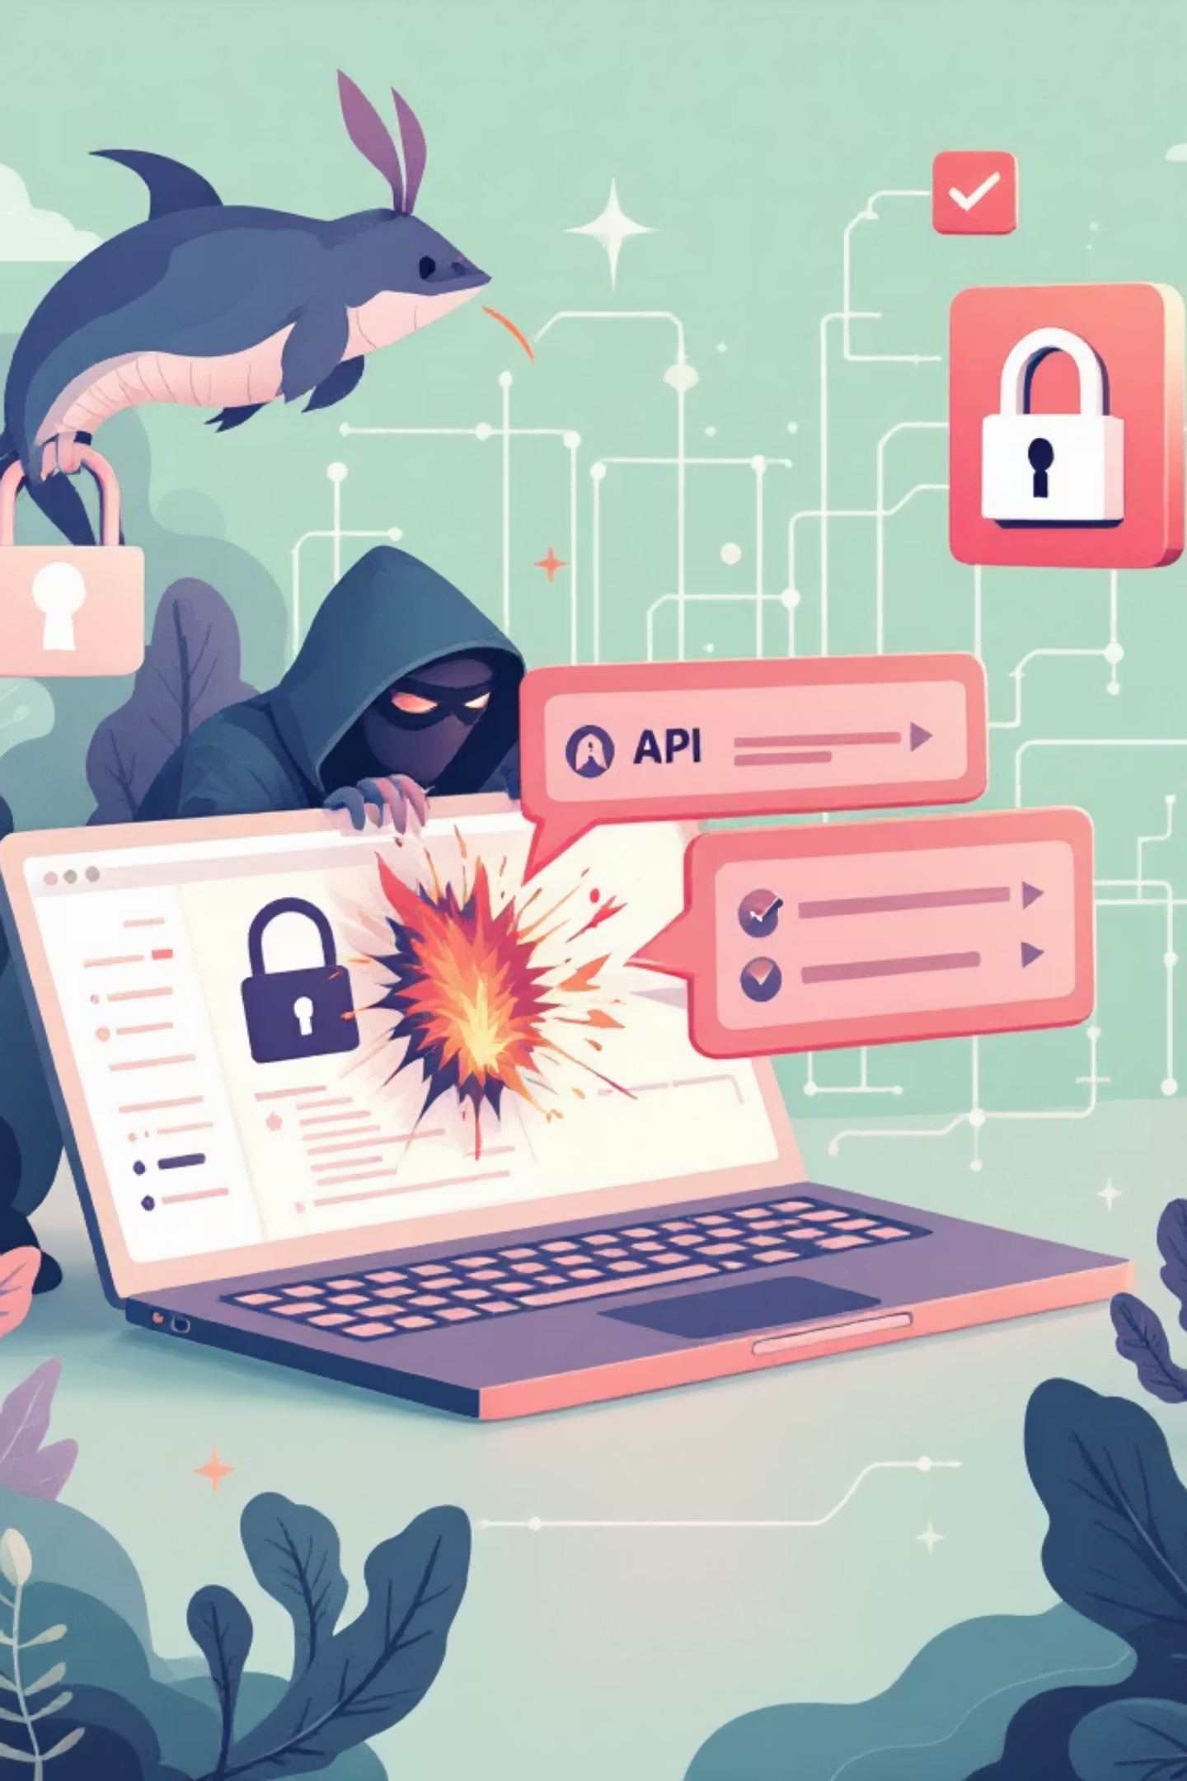
What Are API Endpoint Attacks?
API endpoints are the gateways to backend services in web applications, typically exposed via HTTP/HTTPS (e.g., RESTful APIs using JSON/XML payloads). Attackers target them because they often handle sensitive data like user info, payments, or auth tokens without the same frontend protections (e.g., client-side validation). Here's how attacks work, common methods, and real-world examples—tailored for pentesting these in authorized scopes.

Slide 3
Core Mechanics of API Attacks
APIs operate on requests (GET/POST/PUT/DELETE/etc.) to endpoints like /api/users/{id} or /api/v1/login. Attackers exploit:
Lack of Authentication/Authorization
Input Mishandling
Business Logic Flaws
Over-exposure
No sanitization, leading to injection or overflow.
Endpoints revealing stack traces, versions, or internal data.
Bypassing rate limits, IDOR (Insecure Direct Object Reference), or parameter tampering.
Public or weakly protected endpoints.
Attack flow: Enumerate endpoints → Fuzz parameters → Exploit vulns → Escalate (e.g., data exfil, RCE).

Slide 4
Attack Techniques
1
Enumeration & Discovery
2
Broken Authentication
3
Injection Attacks
Use tools like ffuf, gobuster, or dirsearch with wordlists (e.g., RAAPI.txt from SecLists).
Bruteforce weak creds, predict tokens, or bypass via missing JWT validation.
SQLi/NoSQLi: Inject payloads in query params/body (e.g., {"username": "admin' OR 1=1--"}).
Example: ffuf -u https://api.target.com/FUZZ -w /path/to/api-wordlist.txt -H "Authorization: Bearer YOUR_TOKEN"
Pentest: hydra -l admin -P rockyou.txt target.com http-post-form "/api/login:username=^USER^&password=^PASS^:Invalid".
Command/XSS: If unsanitized, chain to RCE (e.g., GraphQL introspection for schema leaks).
Tool: sqlmap -u "https://api.target.com/users?id=1" --batch --dump.
Attackers predict paths like /admin, /debug, /v1/internal.

Slide 5
IDOR, Mass Assignment & More
IDOR & Mass Assignment
Rate Limiting & DoS
Change user_id=123 to user_id=456 to access others' data.
Mass assign: POST {"admin": true} to /api/users if blacklisting fails.
Pentest: Burp Intruder to iterate IDs; check responses for leaks.
Flood endpoints; bypass via rotating IPs/proxies or logic flaws (e.g., auth before limit check).
Tool: slowloris or hey for load testing.
API-Specific: BOLA, Excessive Data Exposure
GET /api/orders dumps all users' orders.
GraphQL: Batch queries to evade limits.

Slide 6
Pentest Workflow
1
1
Phase 1: Recon & Mapping (1-2 hours)
Phase 2: Authentication Handling (30 min)
1. Collect API docs/spec: Check /swagger.json, /openapi.json, /.well-known/. Browser dev tools → Network tab for live endpoints.
1. Identify auth methods (Basic/JWT/OAuth/API keys)
2. Enumerate endpoints:
curl -X GET "https://api.target.com/info" -H "Authorization: Bearer TOKEN"
ffuf -u https://api.target.com/FUZZ -w raft-medium-directories.txt -H "User-Agent: Mozilla/5.0"
gobuster dir -u https://api.target.com -w api-wordlist.txt -x json,xml
2. Extract tokens: Login flow: Burp → login → copy JWT. Decode: jwt.io (check alg=HS256→none swap)
3. Test token weaknesses: Replay without token. Change user_id/roles in JWT payload.
3. Parameter discovery:
Tools: Burp → Macro → AuthMatrix extension
wfuzz -c -z file,/usr/share/wordlists/dirbuster/directory-list-2.3-medium.txt --hc 404 -u https://api.target.com/users/FUZZ
Output: Full endpoint list (save to notes.txt).

Slide 7
Phase 3: Vulnerability Scanning (Automated - 1 hour)
1. Active scanning:
nuclei -l endpoints.txt -t cves/ -t misconfiguration/ -t exposures/
2. Specialized scanners:
sqlmap -u "https://api.target.com/users?id=1" --batch --level=3
graphql-path-enum https://api.target.com/graphql
3. Rate limit test:
hey -n 1000 -c 10 https://api.target.com/login
Phase 4: Manual Testing (Core - 2-4 hours)
Use Burp Suite (Proxy + Repeater + Intruder)
IDOR Testing
Mass Assignment
BOLA/Broken Access
Input Validation
GET /api/users/123 → Change to 124, 999, admin
POST /api/profile {"name":"test","admin":true,"is_premium":true}
User A token → access User B data. DELETE /api/admin/users/456
XSS, SQLi: ' OR 1=1--, XXE payloads via Burp Intruder
Business Logic
Error Leakage
Price tampering: {"quantity":999}. Race conditions: Turbo Intruder script
Look for stack traces, versions in 4xx/5xx responses

Slide 8
Phase 5: Exploitation & Chaining (1-2 hours)
1. If RCE found:
curl -X POST /api/exec -d '{"cmd":"whoami"}'
2. Data Exfiltration: Download all users via IDOR loop. Script: Python requests + threading.
3. Privilege Escalation: Admin endpoint → token → pivot to internal APIs.
Example Burp Intruder Payload Script (for IDOR):
§123§ → §§§ (payload positions)
Payload sets: numbers 1-10000
Phase 6: Reporting & Cleanup
1. Document findings:
Endpoint
Method
Vuln
Impact
PoC
/api/users/§id§
GET
IDOR
High
Screenshot + curl
2. Evidence: Request/Response screenshots. Video PoC (Burp → Record).
3. Risk Rating: CVSS calculator.
4. Remediation: Auth checks, input validation, RBAC.
Cleanup: Revoke tokens, notify client.

Slide 9

Tools Setup (One-liner)
apt update && apt install -y burpsuite gobuster ffuf nuclei sqlmap hey wfuzz
pip install requests turbo-intruder
Quick-Start Command Chain
# 1. Map
ffuf -u https://target.com/FUZZ -w apis.txt > endpoints.txt
# 2. Scan
nuclei -l endpoints.txt -t cves/
# 3. Manual → Burp everything from here
Note
Always proxy through Burp
(no direct curl after recon)
Save sessions
Burp → Project → Save
Rate limit yourself
(respect ToS even with permission)
Chain vulns
IDOR + XSS = account takeover
Mobile APIs
Same flow + Frida for app reverse

Slide 10


Real-World Attacks
Parler API Hack (2021)
Twitter API Breach (2022)
Attacker enumerated /api/v1/comments without auth, scraped 70TB user data. Exposed via predictable endpoints and no rate limits. (CVE-like: public exposure).
Internal tools leaked via /api/2/users/by with weak employee token scopes—exfiltrated 200M emails. IDOR + token abuse.
Shopify (2019)
Facebook (2019)
IDOR in /api/orders let attackers view any store's orders by tweaking merchant IDs. Affected 180+ stores, led to $1M+ fraud.
/intern/video-call?peer_id= bypassed auth checks, allowing phone number scraping from 1.5M users via video call endpoint.
Optus (2022)
Australian telco's API exposed 10M customers via /identityservices/creditcard with no input validation—scraped via sequential IDOR.
For pentest, start with endpoint mapping (Swagger/OpenAPI docs if available) and auth token handling. Chain vulns: e.g., IDOR → token theft → admin escalation. Tools like Postman, Burp, and AuthMatrix shine here. If you share target details (e.g., API spec, auth type), I can craft specific payloads or scripts.

